Slide 1
Student Wellbeing

Slide 2
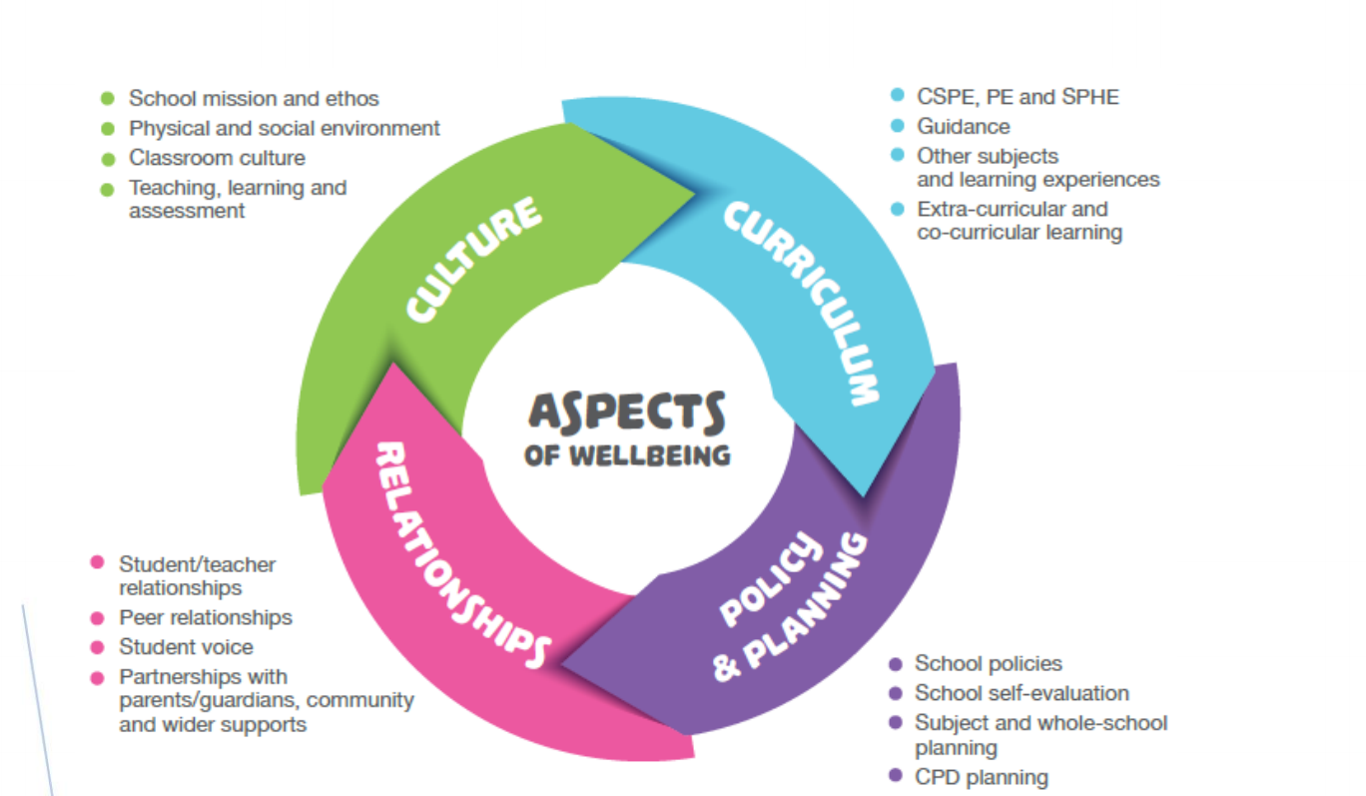
Tutor program
SPHE
CSPE
PE
Extra Curricular and Co Curricular activities.
Guidance

Slide 3
Student
Prefect
Tutor
Year Head
Care Team

Slide 4
Induction for 1st Years.
School visits
Induction day in May each year
2 induction days in August
Prefects – meet every morning
Tutor Time

Slide 5
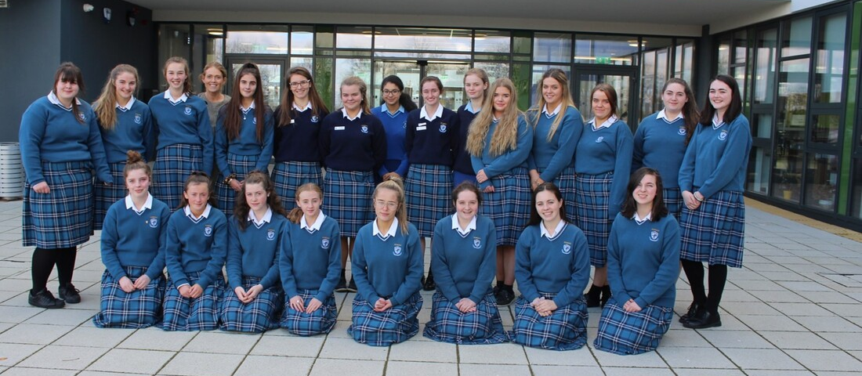
Student Council
2020

Slide 6
Student Council….Voice of the students..
Some topics to look at:
Body Image
Climate Change
Healthy Body – Healthy Mind
Mental Health Awareness

Slide 7
National Mental Health Week October 2019

Slide 8
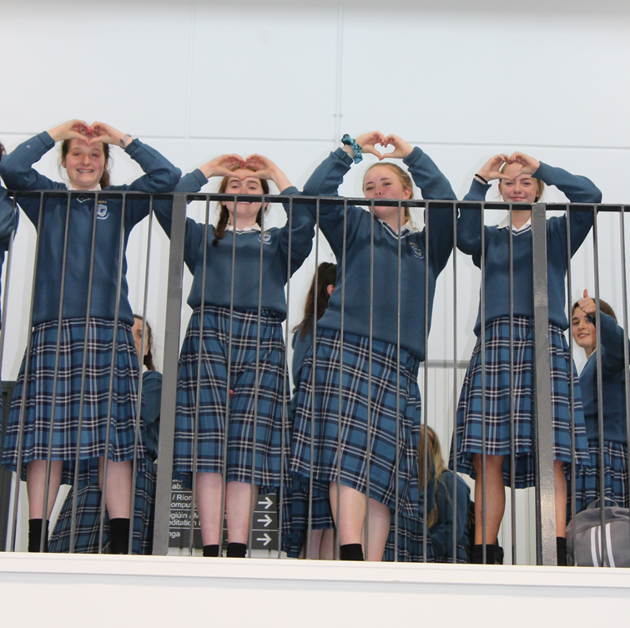
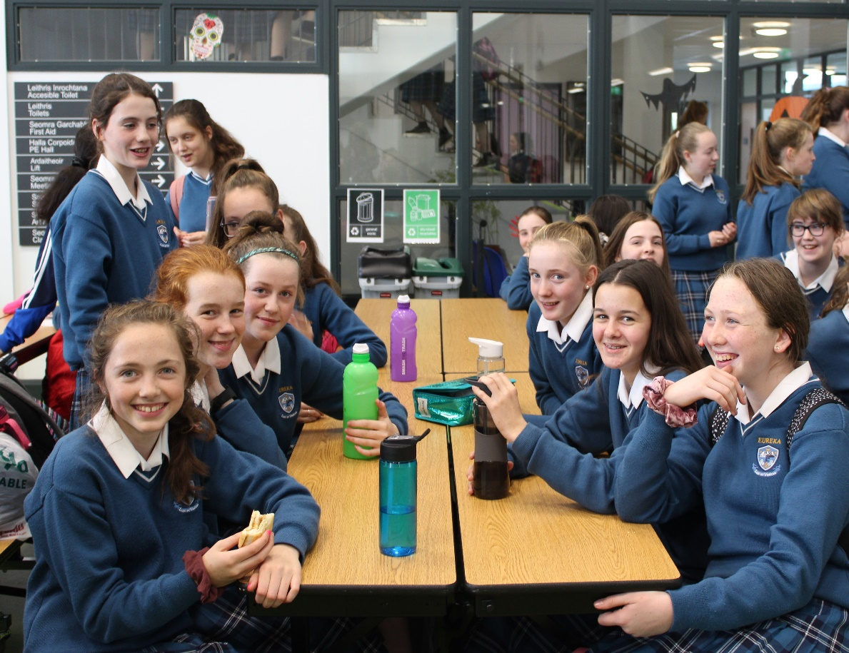
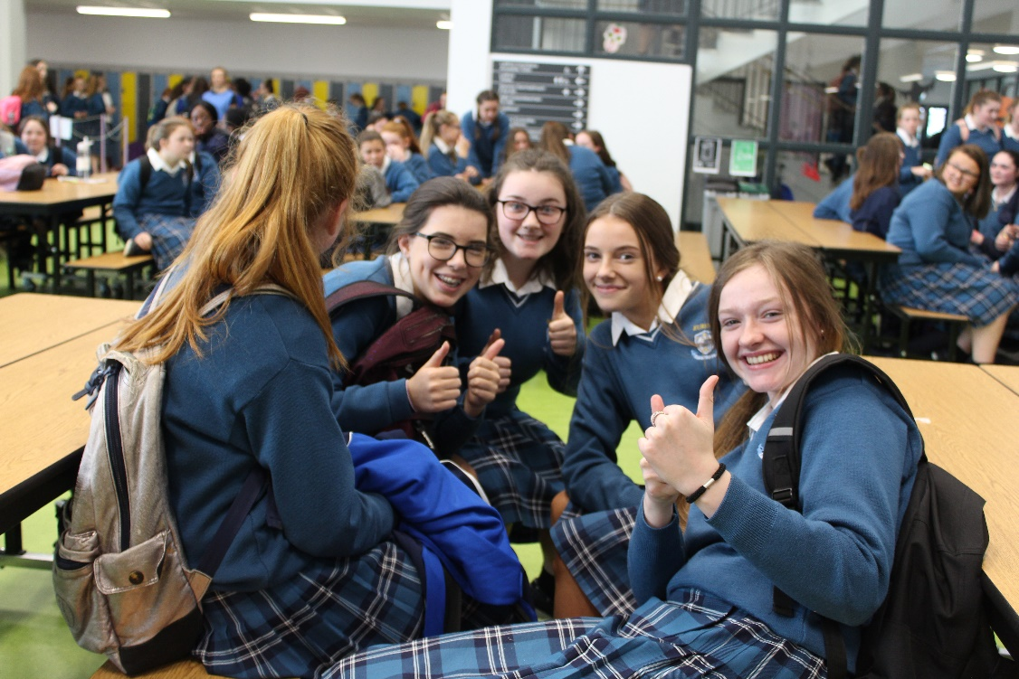
World Mental
Health day

Slide 9
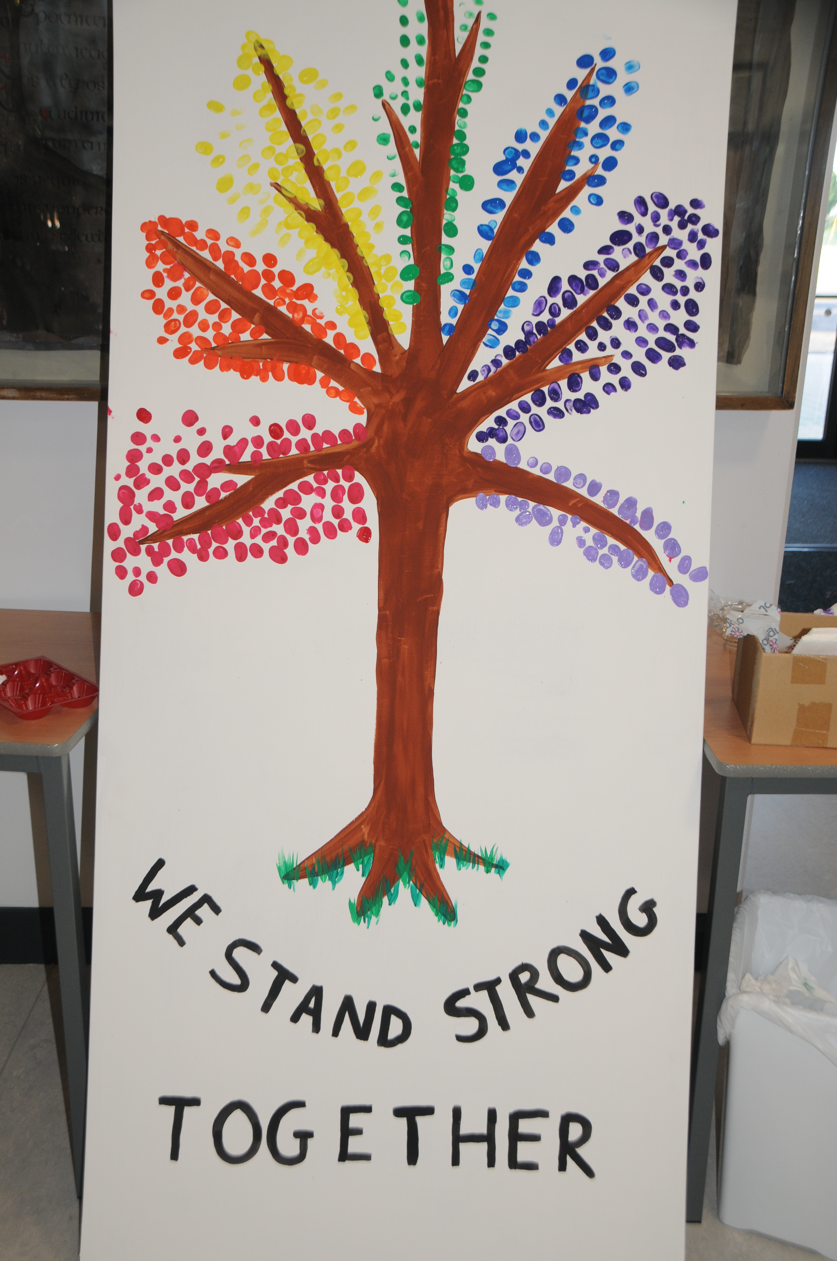
Anti Bullying and Inclusive School

Slide 10
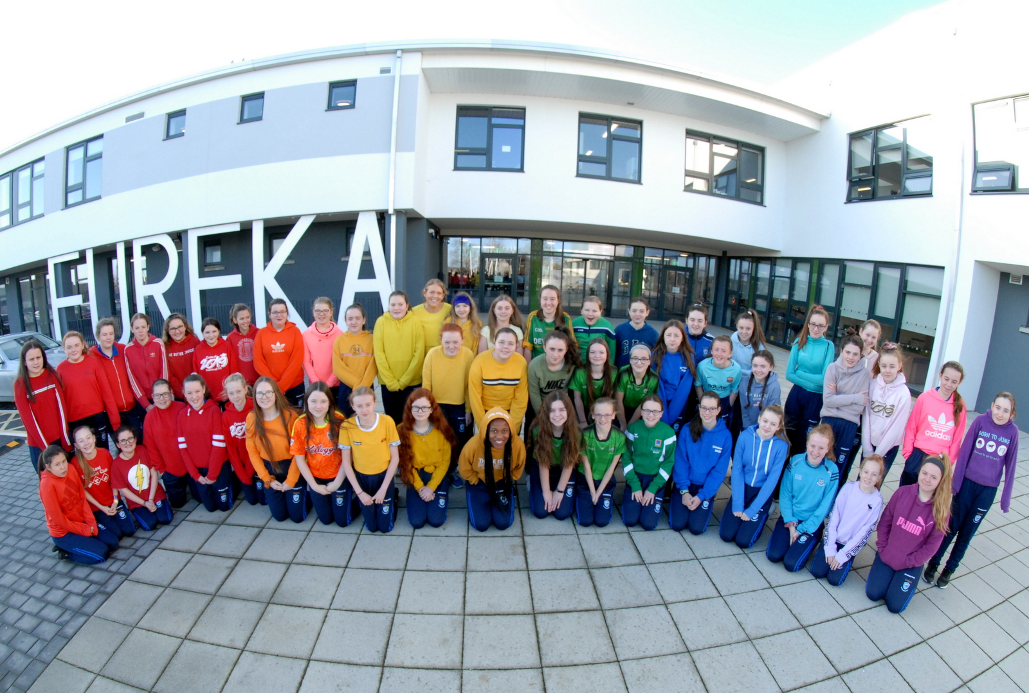
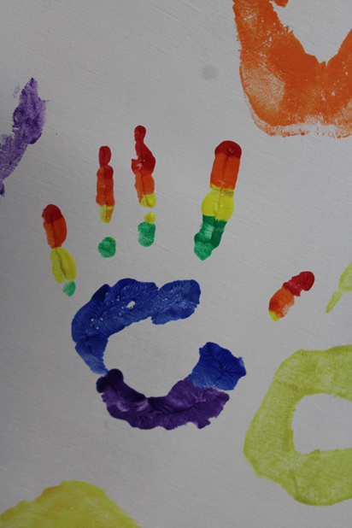
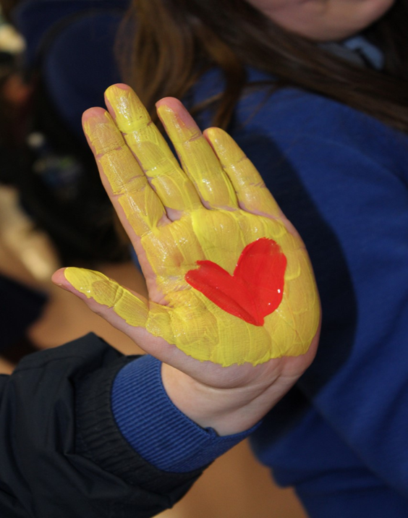
Inclusivity Week

Slide 11
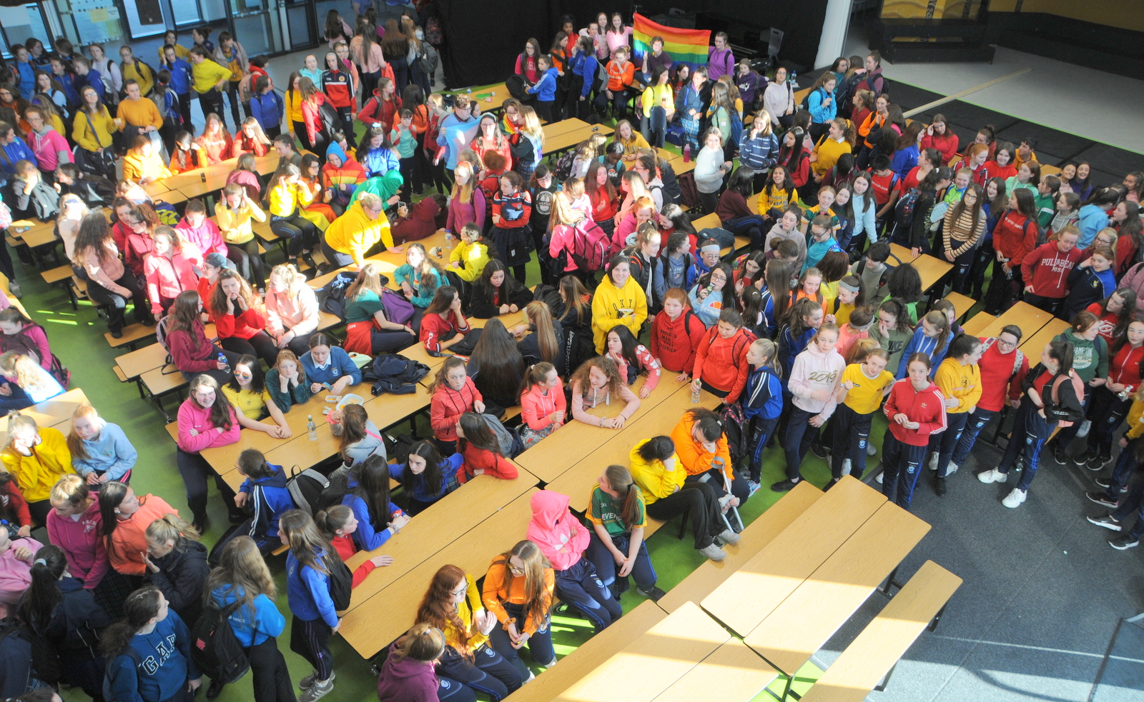

Slide 12
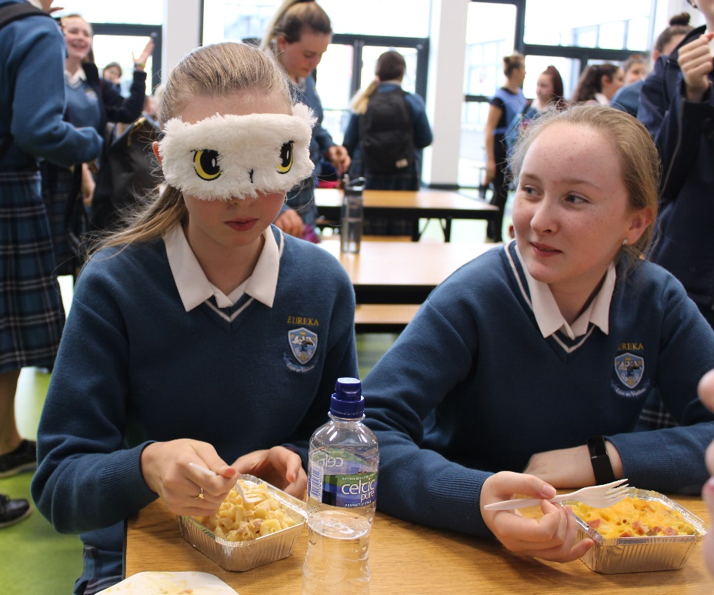
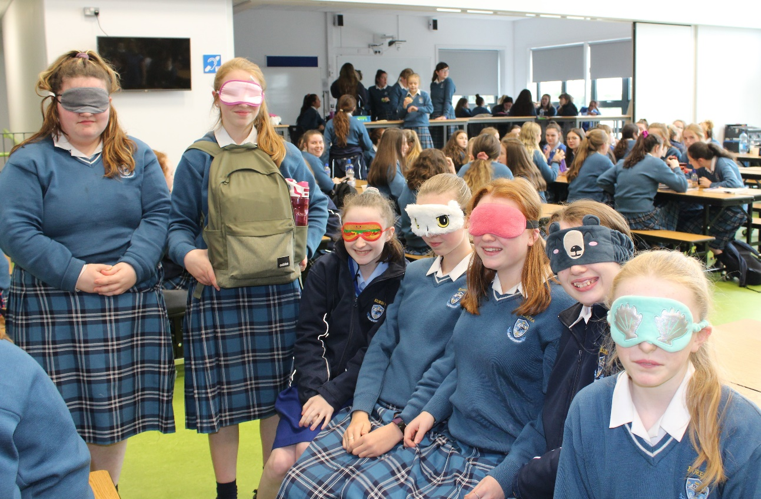
Fundraiser for National Council for the Blind

Slide 13
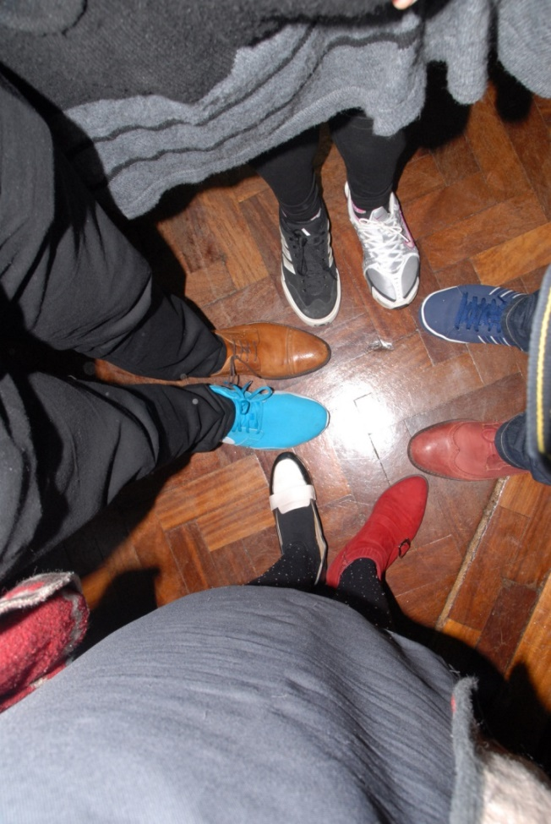
Walk in
my shoes

Slide 14
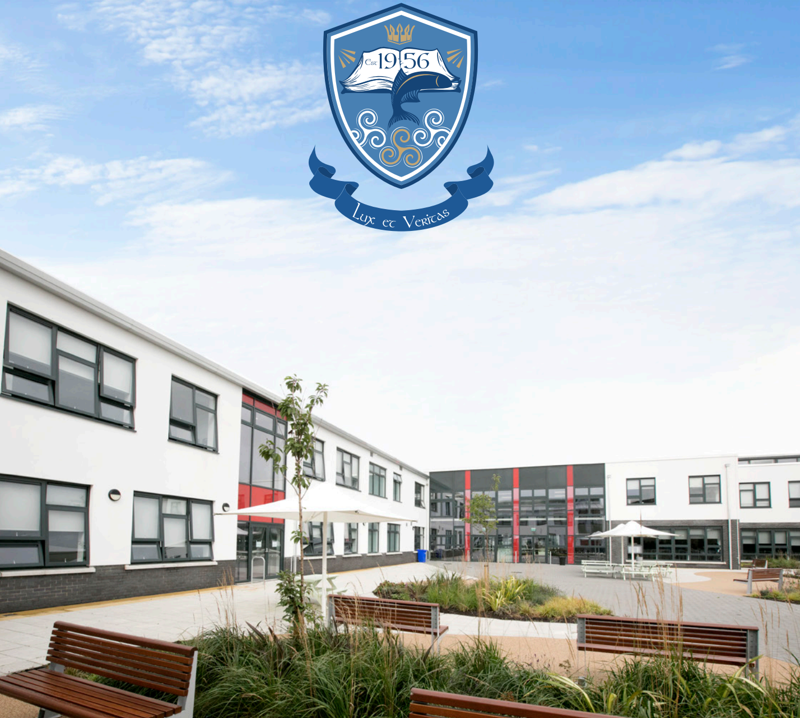
-Ms.Flanagan-
Guidance Counsellor
-Ms.Burke-
School Counsellor

Slide 15
How to access the guidance service
Student centred
See counselling policy in school journal

