Slide 1
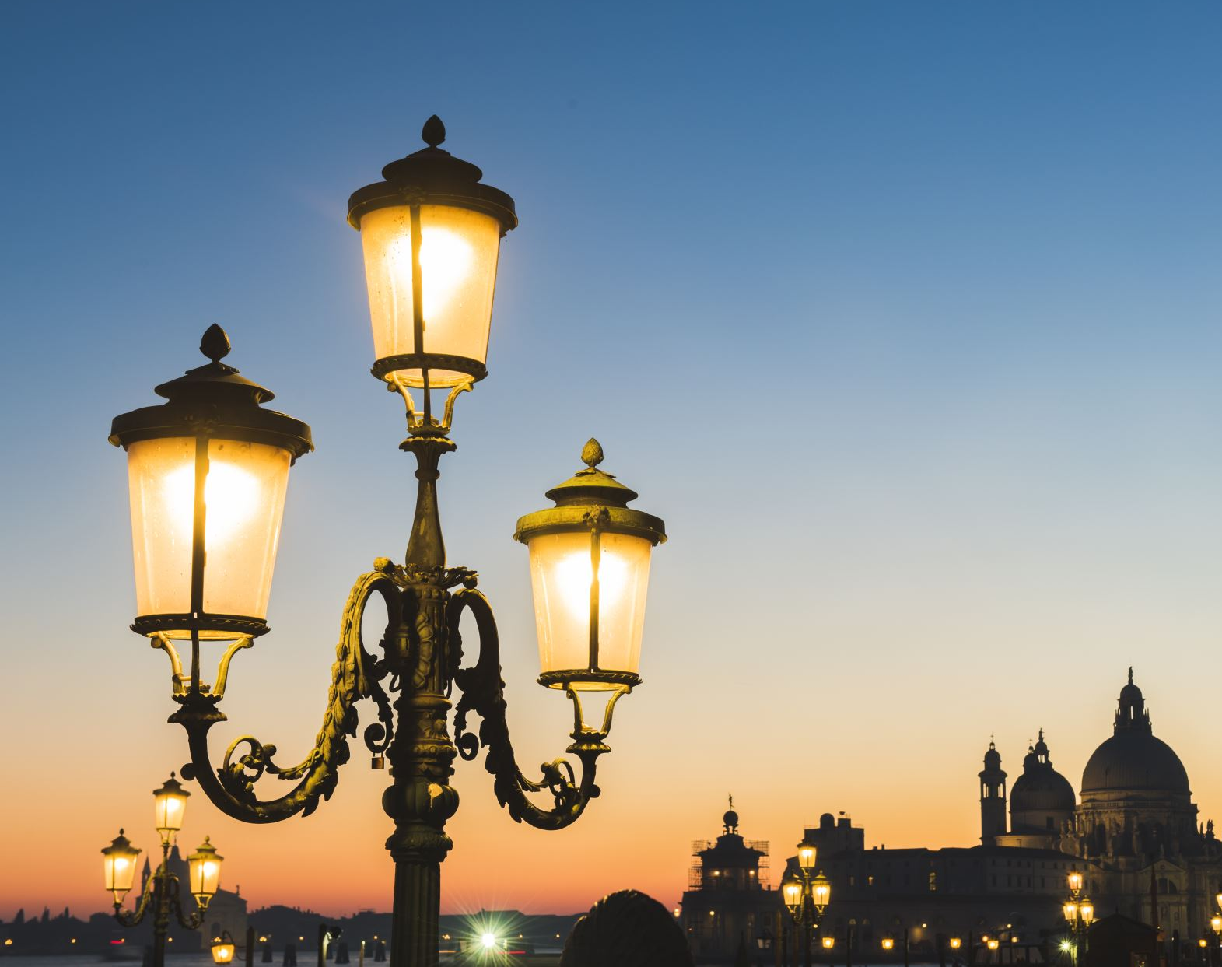
Bienvenue à la langue francaise

Slide 2
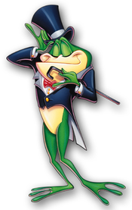
Why learn French?
More than three hundred million people speak french on five continents.
French is the only language, alongside English, that is taught in every country in the world.
The ability to speak French and English is an advantage on the international job market.
French is both a working language and an official language of the United Nations, The European Union, UNESO, NATO, and the international courts.
This Photo by Unknown author is licensed under CC BY-SA.

Slide 3
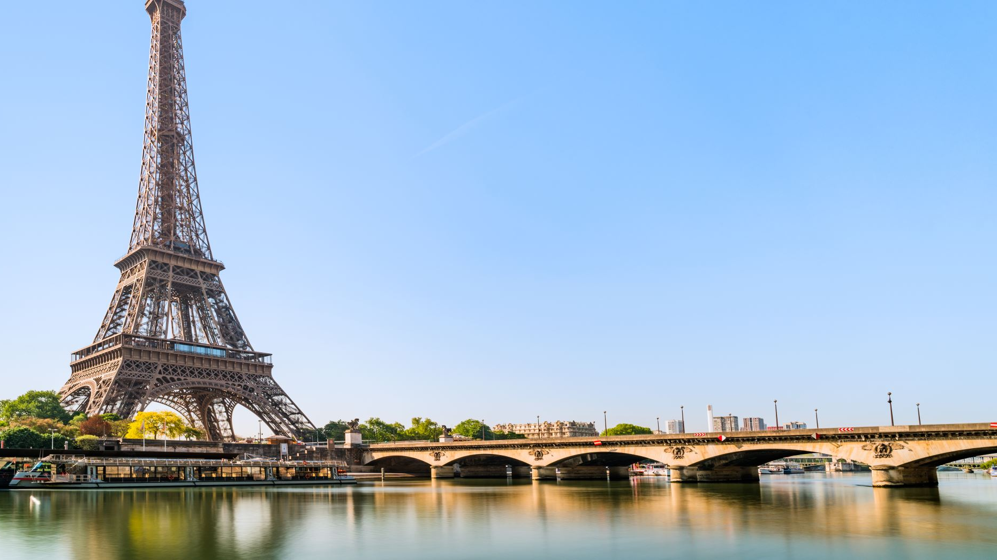
An overview of the French programme
The junior cycle :
First years do a taster programme and then choose to continue one of the three modern foreign languages offered.
They can continue with French to Third year for the junior cycle, where at the end of third year they sit a common french paper.
There is the option of doing Transition Year.
In senior cycle french , they continue for two more years (fifth and sixth year)

Slide 4
The curriculum
From first to third year students complete 200 hours of French for the Junior cycle. During these years, pupils will build an array of:
Oral skills
Aural skills
Reading skills
Cultural awareness
Written skills

Slide 5
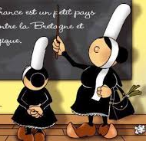
Class activities
For class engagement we use various methodologies for example:
Kahoot, quizlet, puppet pal
Board games, bingo
Pair work/group work
French week
Art competitions, quizzes
Songs and dance

Slide 6
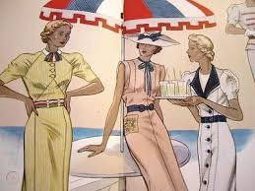
Senior cycle
In Transition year students learn about:
French cinema/film studies
French culture in more detail
Develop oral competence
In the Leaving Cert Cycle students currently use the book “Tout va bien “over two years. The state exam consists of:
Oral exam
Aural exam
Written paper
Reading comprehensions

Slide 7
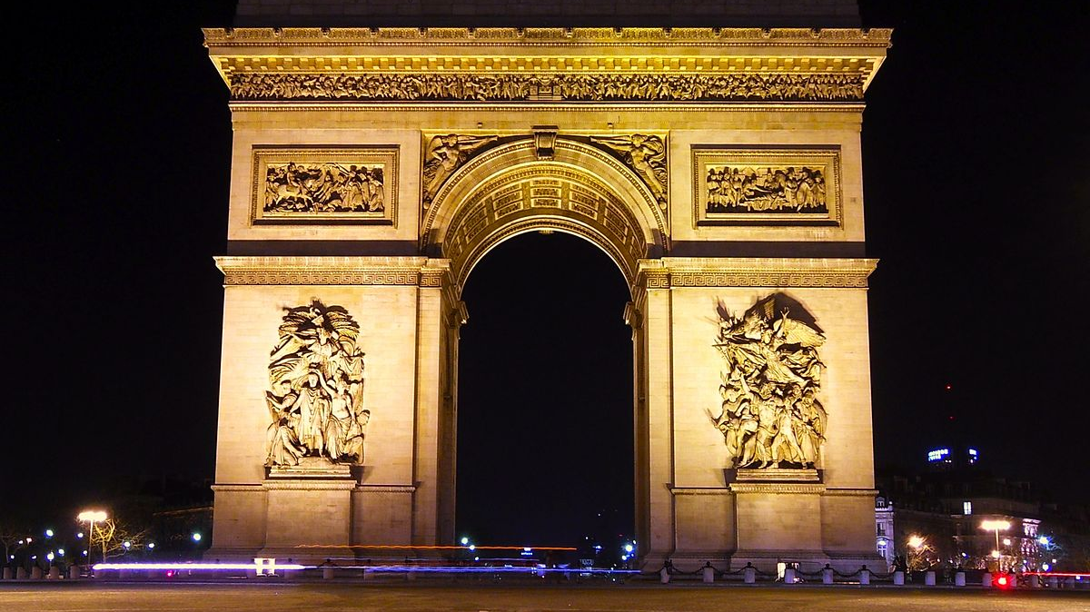
Extra curricular activities
The French theatre group come to the school to perform plays for the junior and senior cycle
Second and Third year students have benefitted from trips to Paris at Halloween.
This Photo by Unknown author is licensed under CC BY-SA.

Slide 8
French Theatre slide show

