Slide 1
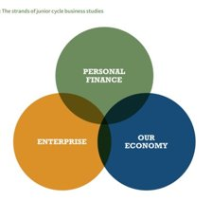
Business Studies
Junior Cycle

Slide 2
In Business Studies the focus is on improving students understanding of the business environment and developing skills for life, work and further study through the three inter-connected strands:​
Personal finance​
Enterprise​
Our economy
Click to add t

Slide 3
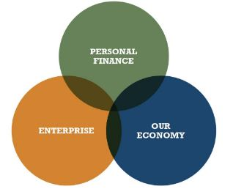
Studying business helps prepare young people for a future where the world of business is changing at a fast pace, the global economy is constantly evolving, and the web is changing the nature of how we do business.
Theirs will be transformed workplace, society and environment.

Slide 4
Why choose Business Studies?
Business Studies helps you to make more informed decisions in the everyday business of living.
It develops the skill of budgeting and accounting and a greater understanding of your consumer rights.
It informs you about the world of work.
It encourages you to think about how and why people start up in business and why you too might also consider starting a business.
It gives you a better understanding of how our economy works.
You develop an understanding of the role of Government and the EU.

Slide 5
What will I learn if I choose Business Studies?
How to collect, organise and record financial information for yourself, your family, your business or any business you may work for in the future.
The process of developing a new product/service, from ideas to product launch.
What your Rights and Responsibilities are as both a Consumer and Employee.
How to calculate wages and to understand the tax deductions etc. on your payslip.
How to conduct research, evaluation and deliver a presentation.

Slide 6
What will I learn if I choose Business Studies?
cont'd
Business students are encouraged to be enterprising, to generate ideas, to consider the choices they make and to think critically about current issues in business.
Studying business empowers students to become more informed and responsible as consumers and citizens.

Slide 7
How will Business Studies benefit me?
Having studied business studies at junior cycle, students will have acquired knowledge, understanding and skills such as working with others, planning and organising, researching and thinking creatively, communicating and reflecting and so be better prepared to succeed in senior cycle.
The two business subjects offered in Eureka at leaving certificate level – Business and Accounting. If you wish to study any of these subjects for the Leaving Certificate, it would be advantageous for you to have studied Junior Certificate Business Studies.

